Slide 1
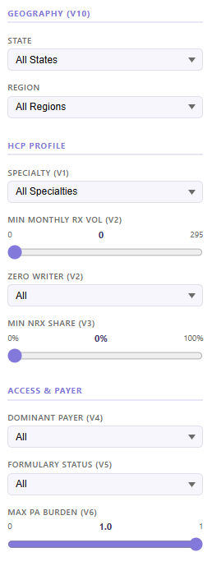
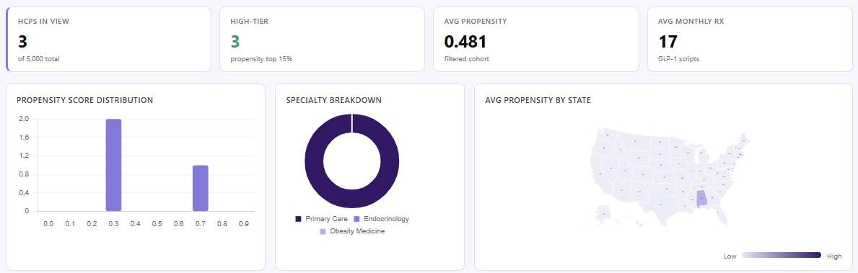
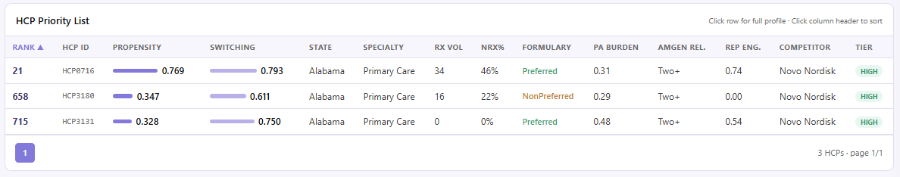
Rabivy - HCP Propensity Dashboard
AX Pharmaceuticals · Rabivy Commercial Launch · AX Consult Group
N = 15 000 HCPs

Slide 2
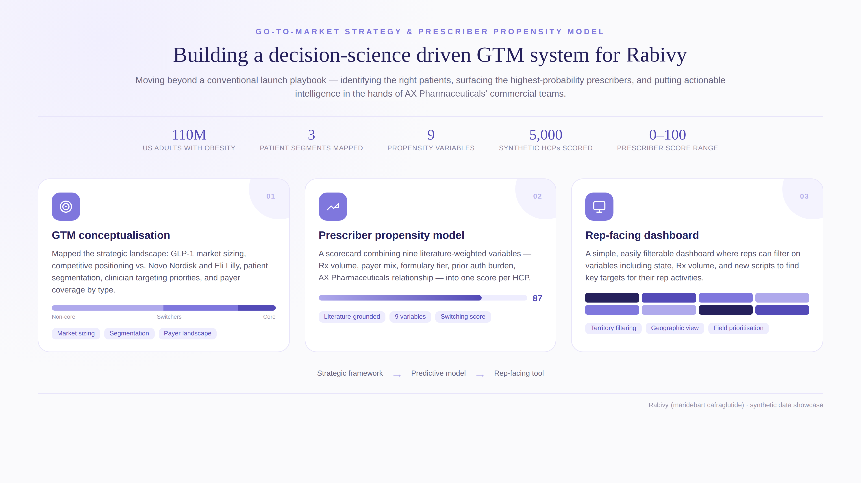
1

